Slide 1

Customer Personality Analysis using the Unsupervised Learning Methods

Slide 2
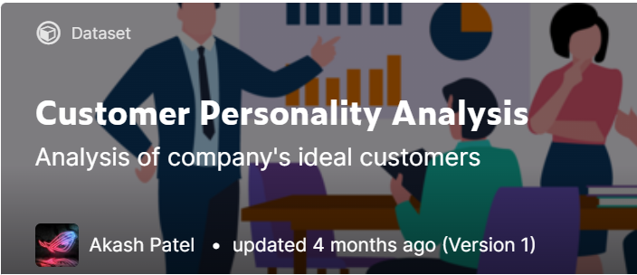
1. Topic
Purpose: Explore different types of customer segments and explain why they are a segment by performing clustering in the data set provided by Kaggle.
Method: Unsupervised Learning methods - K-Means, Agglomerative, K-Medoids

Slide 3
2. Exploratory Data Analysis - about data set
ID
Year_Birth
Education
Marital_Status
Income
Kidhome
Teenhome
Dt_Customer
Recency
Complain
MntWines
MntFruits
MntMeatProducts
MntFishProducts
MntSweetProducts
MntGoldProds
NumDealsPurchases
Response
AcceptedCmp1
AcceptedCmp2
AcceptedCmp3
AcceptedCmp4
AcceptedCmp5
NumWebPurchases
NumCatalogPurchases
NumStorePurchases
NumWebVisitsMonth
Place
Products
Promotion
This data set consists of 29 features and 2240 data points. They can be categorized into 4 subsets.
People

Slide 4
2. Exploratory Data Analysis - feature engineering (1)
• Features added: Age, Spending, Num_Children, Enrollment_Time
Features Added | Feature Description
Age | Customer's age
Spending | Total amount spent on all products
Num_Children | Number of kids or teenagers in customer's household
Enrollment_Time | Customer's enrollment time with the company

Slide 5
2. Exploratory Data Analysis - feature engineering (2)
• Features removed: ID, Birth_Year, Dt_Customer, Z_CostContact, Z_Revenue
Features Removed | Reason
ID | We removed these 4 features because they are redundant and useless to customer personalities.
Z_CostContact
Z_Revenue
Year_Birth | We added Age and Enrollment_Time to replace them.
Dt_Customer

Slide 6
2. Exploratory Data Analysis - feature engineering (3)
• Feature modified: Marital_Status
Marital_Status is a categorical feature that contains: divorced, widow, alone, absurd, YOLO, single, together, married.
There are only two major types of marital status: with or without a partner. Thus we divided all marital status into two categories: “Single” and “Pair”, in order to replace the original status.
Original text data in Marital_Status | Updated text data in Marital_Status
Divorced, Widow, Alone, Absurd, YOLO, Single | Single
Together, Married | Pair

Slide 7
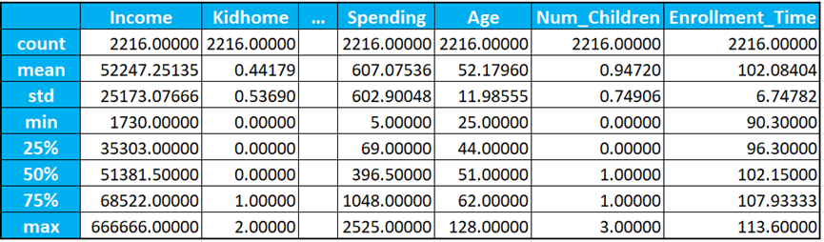
2. Exploratory Data Analysis - numeric summary (1)
Data set description of numeric summary: after feature engineering, there are 28 features in this data set.

Slide 8
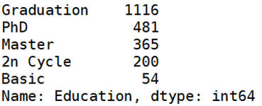

2. Exploratory Data Analysis - numeric summary (2)
Categorical features: Education and Marital_Status
The number of customers with graduation level is much more than other education levels, and the number of customers with basic education level is significantly less than the others. In addition, the number of customers with partners is far more than those without a partner.

Slide 9
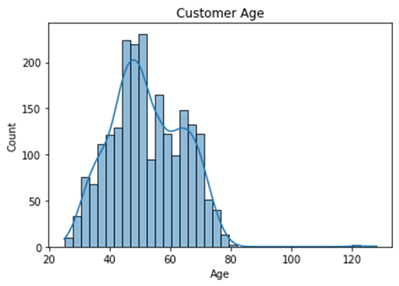
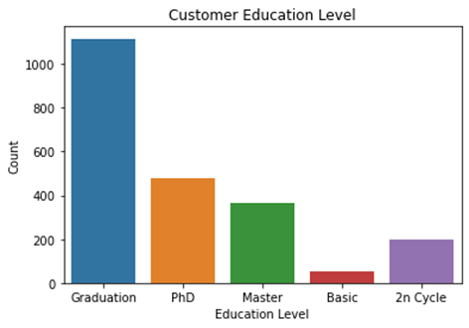
2. Exploratory Data Analysis - graphing summary (1)
Most customers are middle-aged people; seems that many of them are in 40s-50s.
The number of customers with an education level of Graduation is significantly more than the others, followed by PhD and Mater.

Slide 10
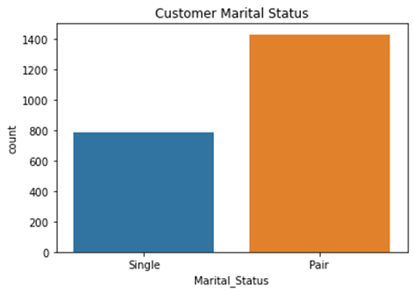
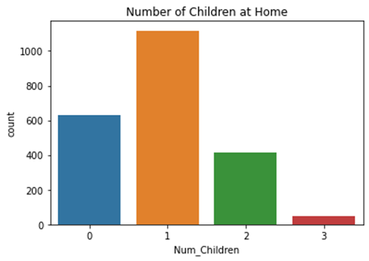
2. Exploratory Data Analysis - graphing summary (2)
The number of customers with a partner is far more than that of single customers.
Most customers have at least one child.

Slide 11
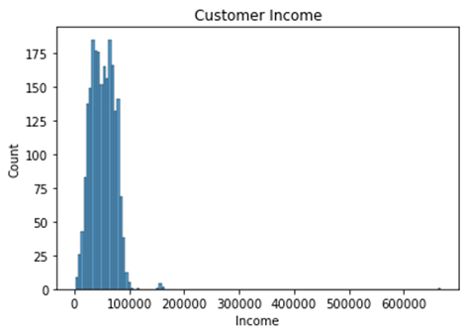
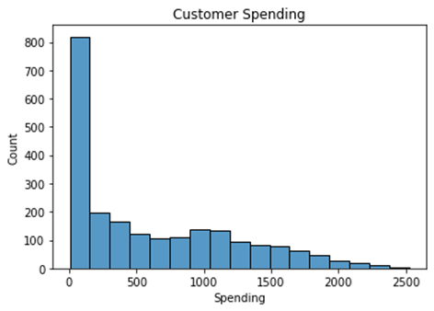
2. Exploratory Data Analysis - graphing summary (3)
Both high-income and low-income earners are in the minority. Seems that most customers’ annual income is approximately between $35,000 and $70,000.
The number of customers with total spending < $500 is significantly more than others.

Slide 12
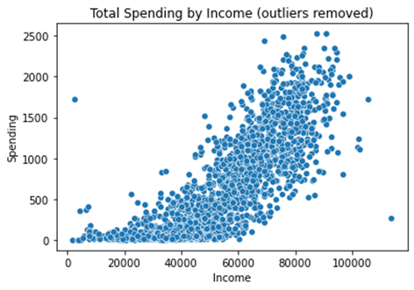
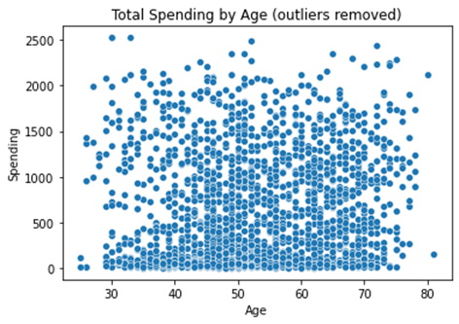
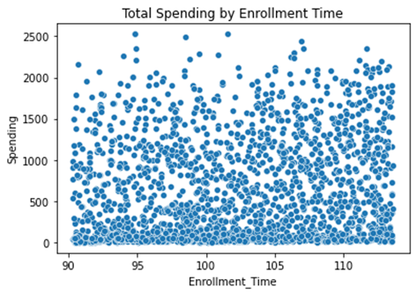
2. Exploratory Data Analysis - graphing summary (4)
As the annual income increases, customers’ total spending on products will also increase substantially.
Total spending of middle-aged customers seems to be higher than that of other people, followed by elderly customers.
It seems that customers with longer enrollment time tend to spend slightly more.

Slide 13
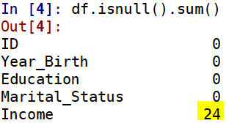
3. Data Preparation - data cleaning (1)
Missingness
24 missing values in Income;
% of missingness in income is: 24/2240 = 1.07%
The probability of missingness is very small. So we ignored it.

Slide 14
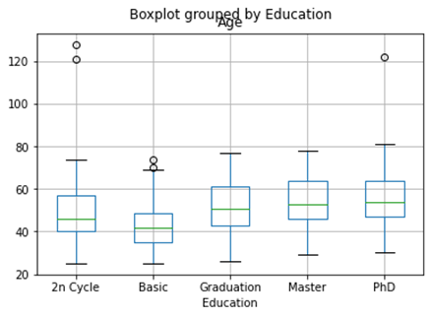
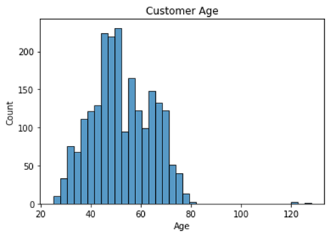
3. Data Preparation - data cleaning (2)
Outliers in Age
IQR_Age = 75% quantile of Age - 25% quantile of Age = 18
25% quantile of Age - 1.5 * IQR_Age = 17
75% quantile of Age + 1.5 * IQR_Age = 89
Age Range: [17,89]
3 outliers removed

Slide 15
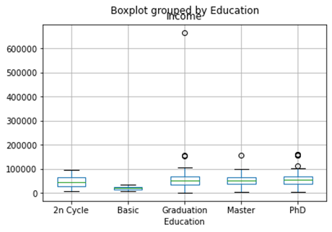

3. Data Preparation - data cleaning (3)
Outliers in Income
IQR_Income = 75% quantile of Income - 25% quantile of Income = 33219
25% quantile of Income - 1.5 * IQR_Income = -14525.5
75% quantile of Income + 1.5 * IQR_Income = 118350.5
Income Range: [0,118350.5]
8 outliers removed

Slide 16
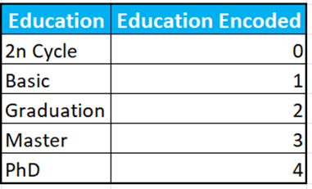
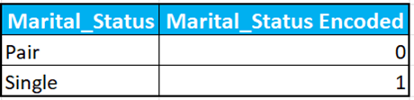
3. Data Preparation - Label Encoding
We used Label Encoding to process these two categorical features that contain text data: Education and Marital_Status.
Label Encoding converted the categories to numeric equivalents as follows:

Slide 17

3. Data Preparation - scaling
We performed Min-Max scaling on the data set so that no variables will dominate our clusters in the subsequent modeling. The formula used is as follows:
This scaling method transfers the original columns to make all observations fall in the range of [0,1]. In this way, all features will be equally treated during the modeling process.

Slide 18
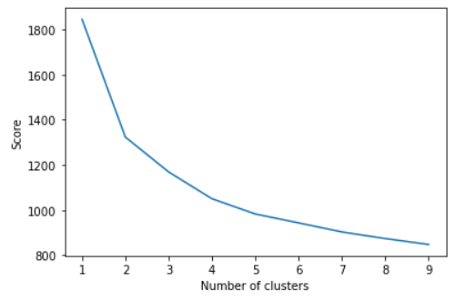
4. Modeling - number of clusters
Use K-mean model to test with different number of clusters:
The Elbow point here appears to be at n = 4

Slide 19
4. Modeling - K Means
Model will perform 10 runs, each run with a different starting point
Each run will process at most 300 iterations
Only include numerical data

Slide 20
4. Modeling - Agglomerative Clustering
The model divide data into 4 clusters, same as K-mean
Use Euclidean distance as the distance metric
Use Ward linkage which will try to minimize within cluster variation
Same as K-mean, only numerical data is included

Slide 21
4. Modeling - K Medoids
Also divide the data into 4 clusters
Use PAM method since it will provide a more accurate result
The distance metric used is Gower’s distance, which is capable to handle categorical data
Mix of numerical data and categorical data are included

Slide 22
5. Insights
Idea:
If our company can figure out what kind of customers are more likely to accept our offer, they can save a lot of money.
Therefore we first find out the cluster which has the highest proportion of data whose response is equal to 1. Then analyze the difference between it with the other clusters.

Slide 23
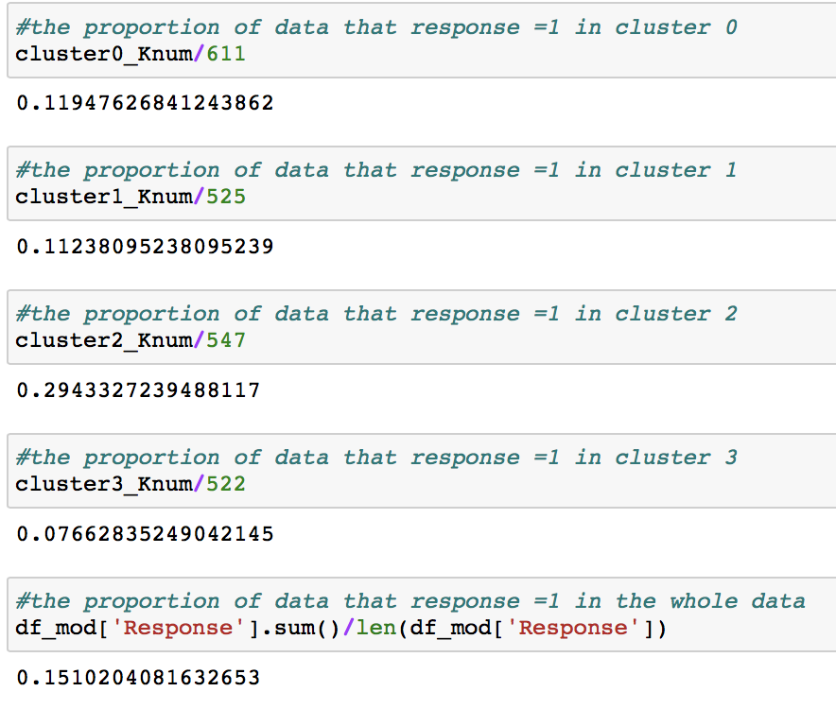
5. Insights
K-Means Clustering
By calculation, there are 611 in cluster 0, 535 in cluster 1, 547 in cluster 2, 522 in cluster 3.
Cluster 2 is the most likely to be response = 1.

Slide 24
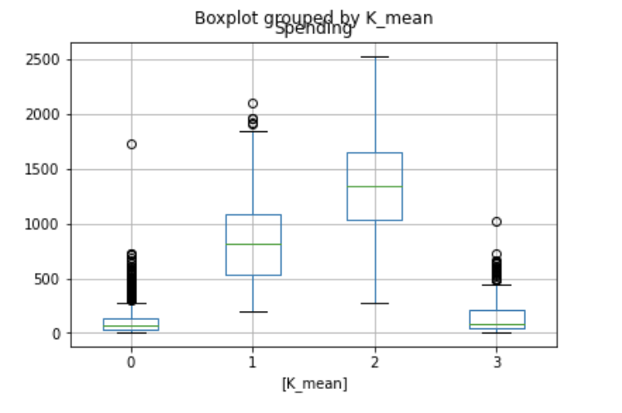
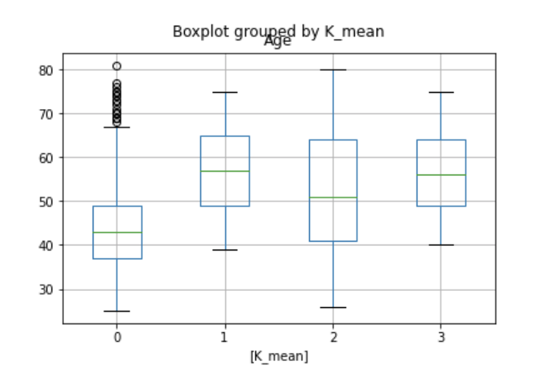
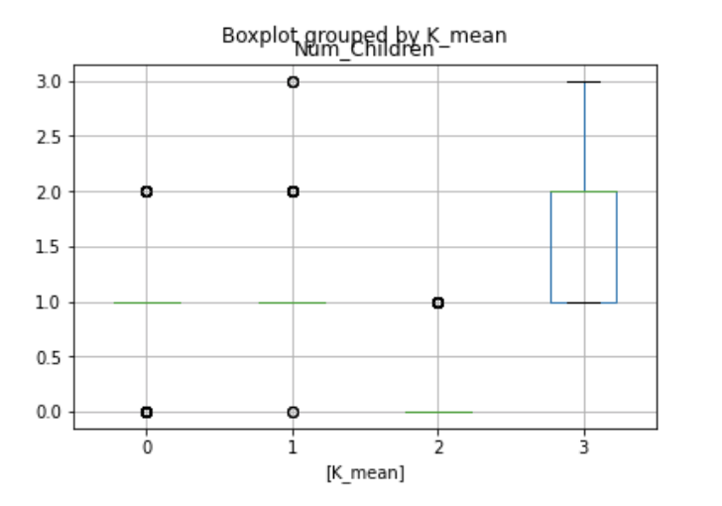
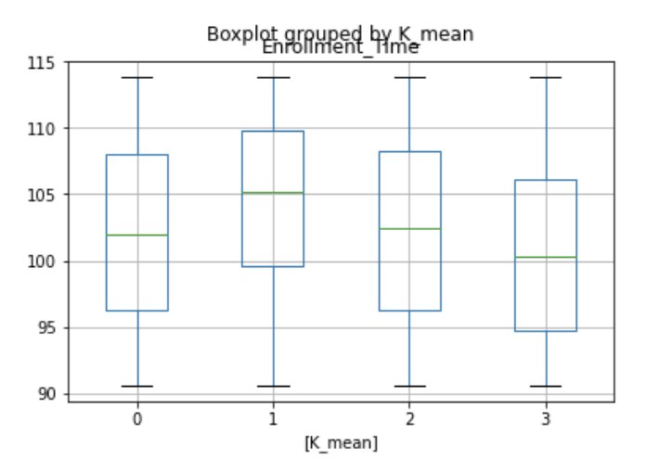
5. Insights
Plot analysis for K mean
From the four figures, We find the spending and Num_Children will influence our target.

Slide 25
5. Insights
Brief idea:
Num_children Spending
Consuming ability The willingness of consuming

Slide 26
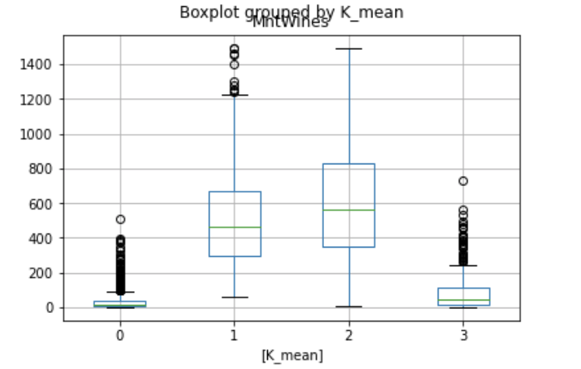
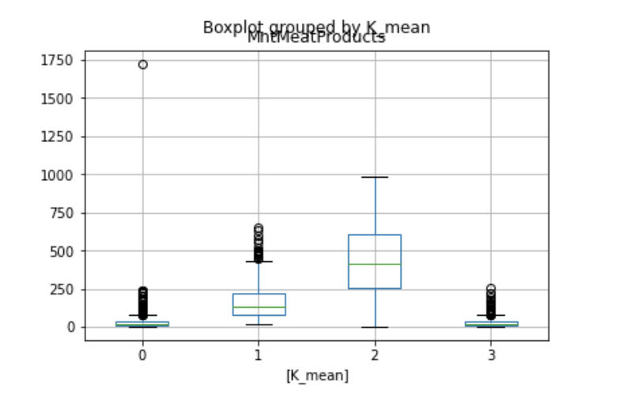
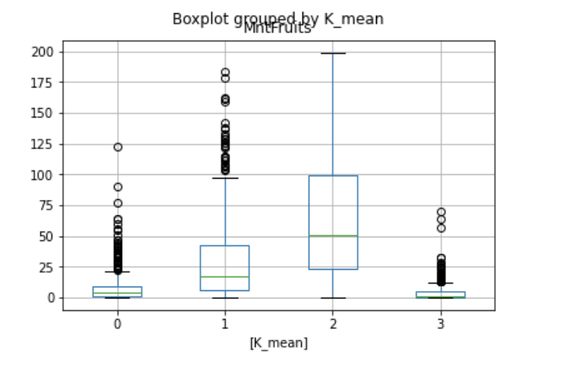
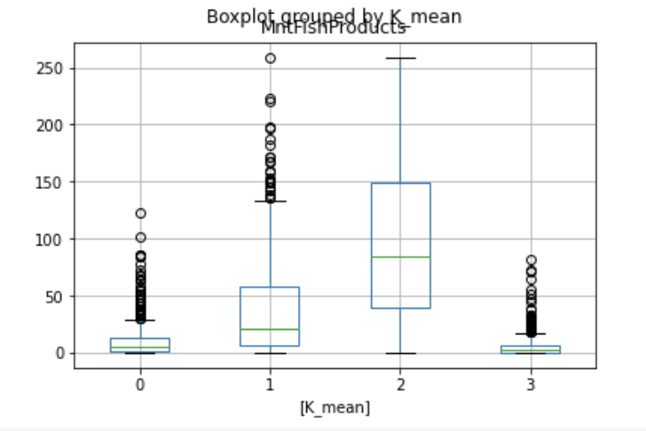
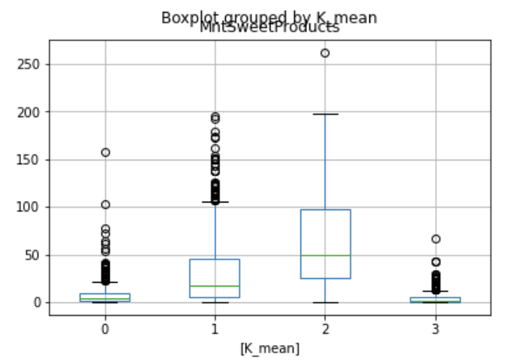
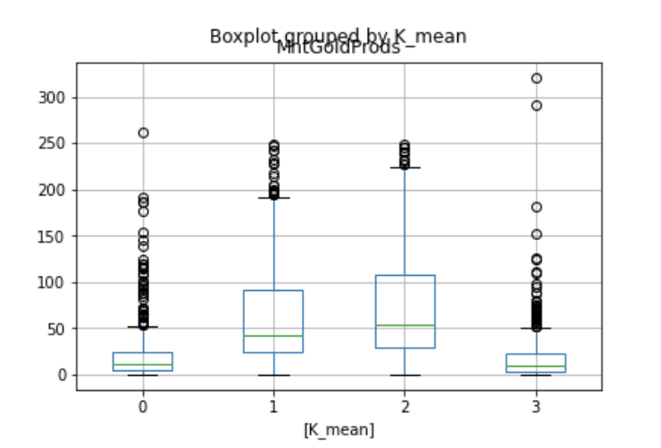
5. Insights
Plot analysis for K mean

Slide 27
5. Insights
Why cluster 1 has a high spending, but it’s proportion of it is even lower than cluster 0?

Slide 28
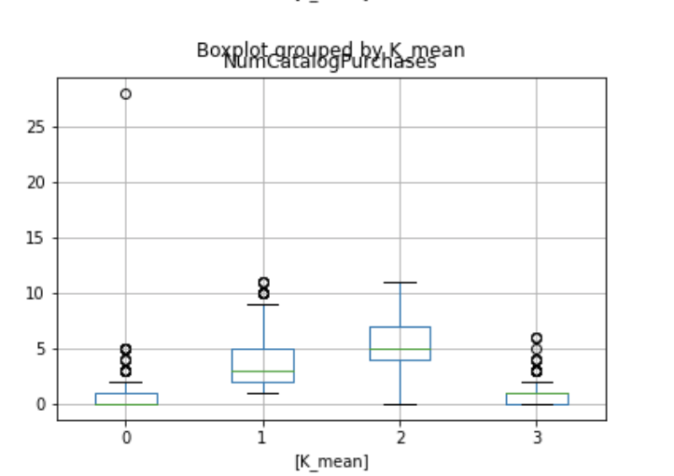
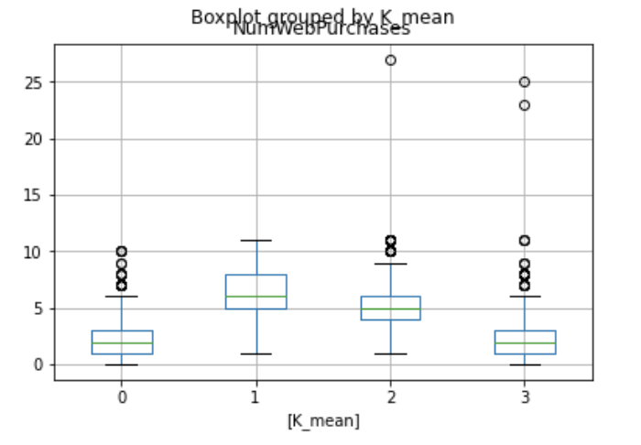
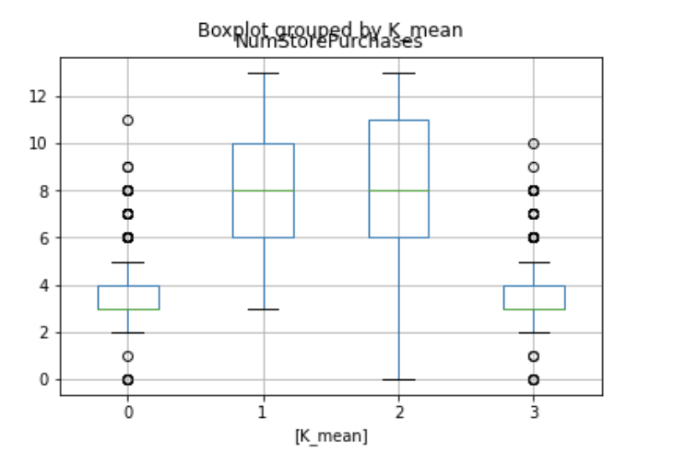
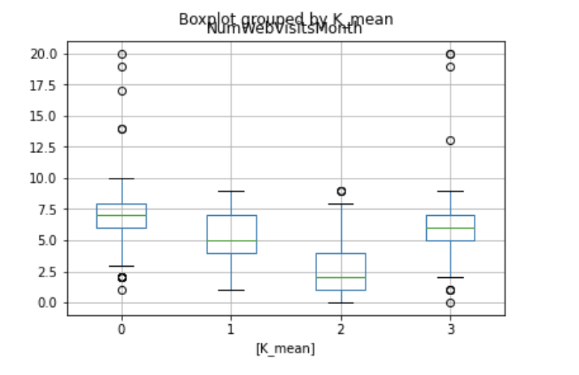
5. Insights
Then we try to analyze the influence of purchasing places.
These four figures above show that our target cluster 2 makes more purchases in store or using catalog instead of online. The cluster that purchases a lot online is less likely to accept the offer in the last campaign. The reason behind that is people are more likely to spend too much online. We can conclude that too much online shopping is more likely to reduce customers’ consuming ability.

Slide 29
5. Insights
Conclusions of the K_Means model:
The company should focus on customers who have:
Strong consuming ability;
Low number of children (which is the most important feature that influences the consuming ability directly);
High spending (for those customers with no children, they would like to spend money while they have strong sunsuming ability).
For people who have weak consuming ability (number of children is large), less spending means rest consuming ability is stronger. Besides, online shopping is more likely to lead people to spend too much that will decrease their consuming ability.

Slide 30
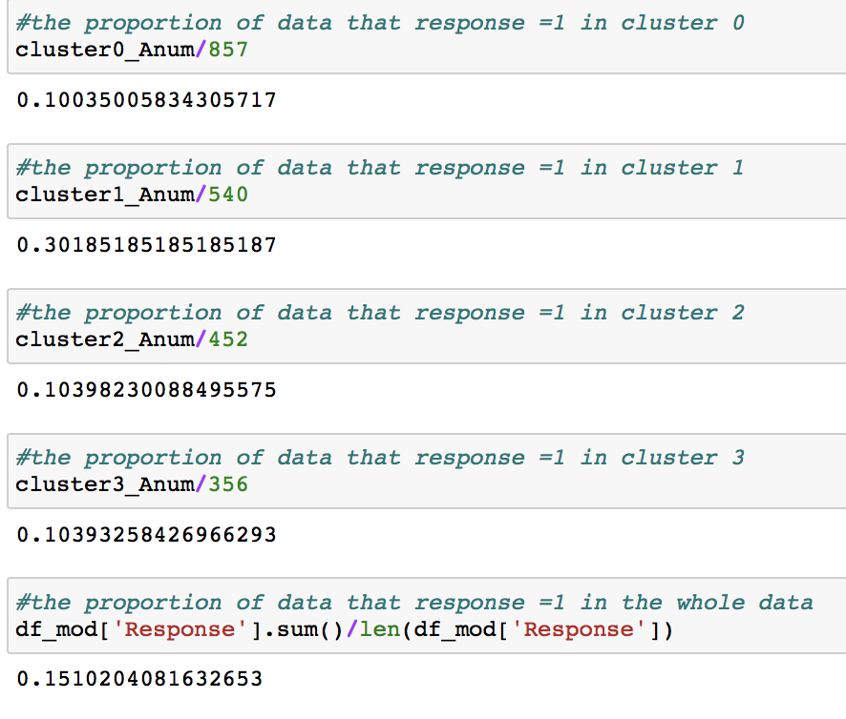
5. Insights
Agglomerative Clustering
From the calculation, we found that the data in cluster 1 is the most likely to have response = 1.

Slide 31
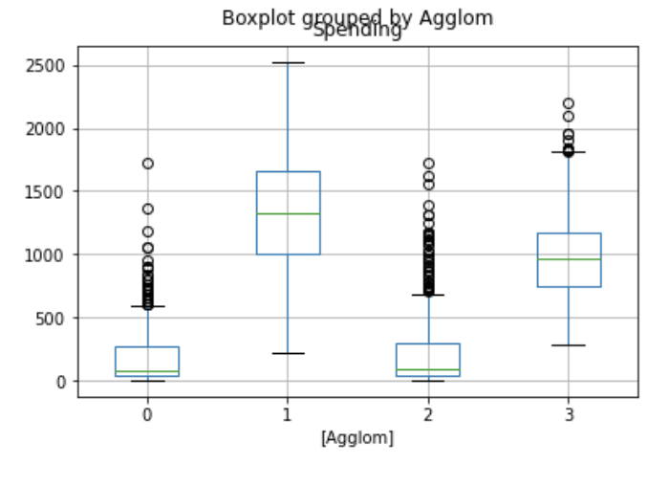
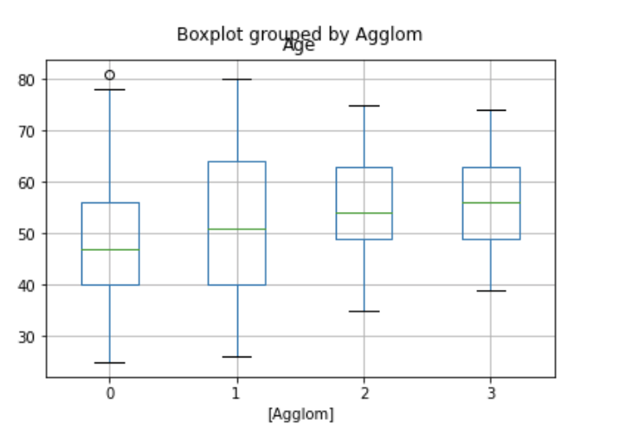
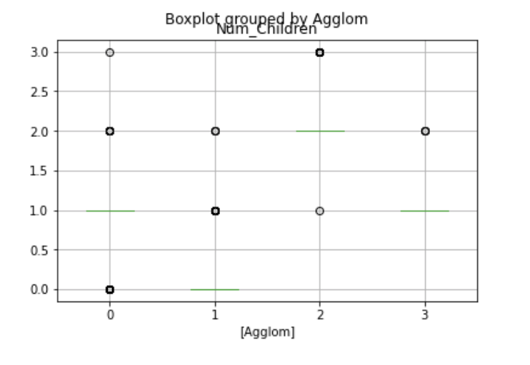
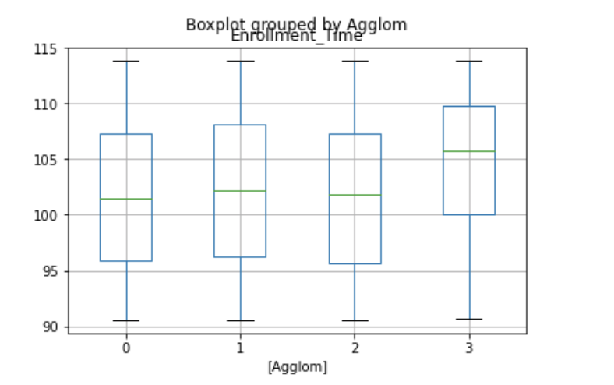
5. Insights
Plot analysis

Slide 32
5. Insights
The conclusions of this model are similar to the conclusions of K mean model.

Slide 33
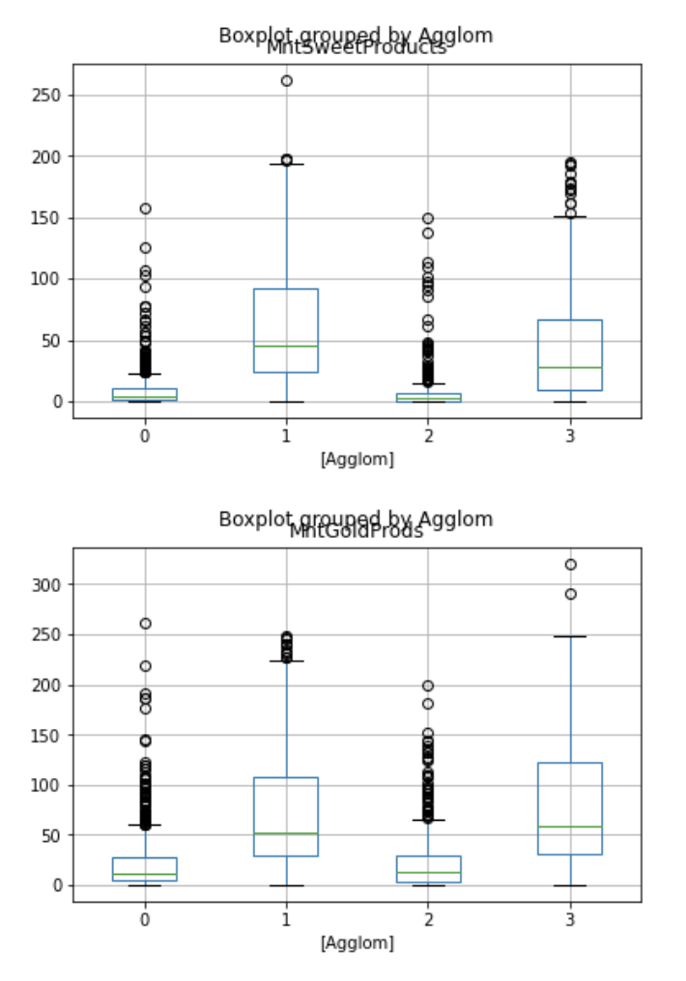
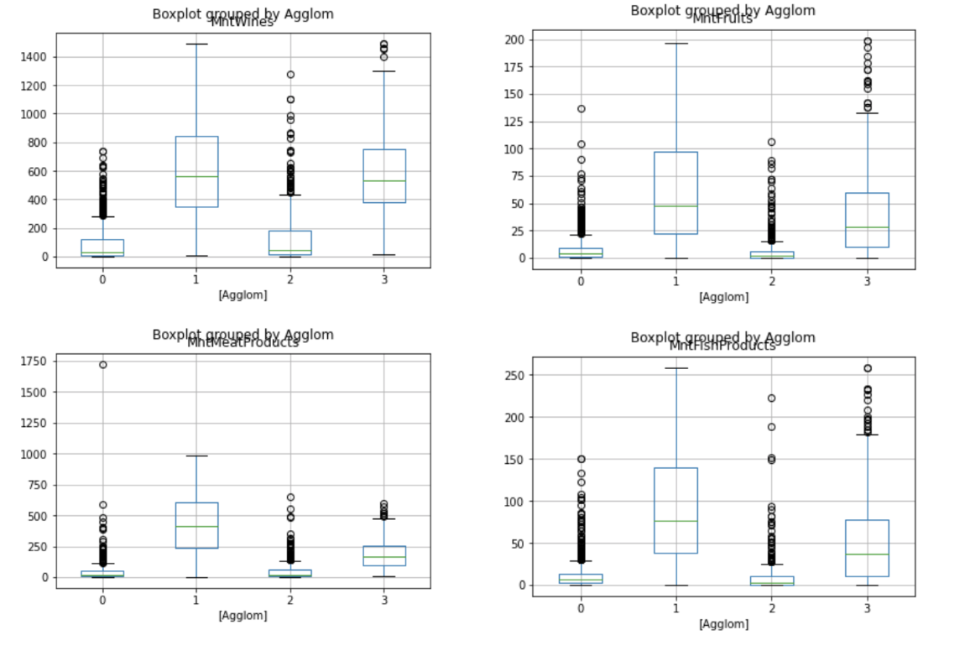
5. Insights
Plot analysis for products feature

Slide 34
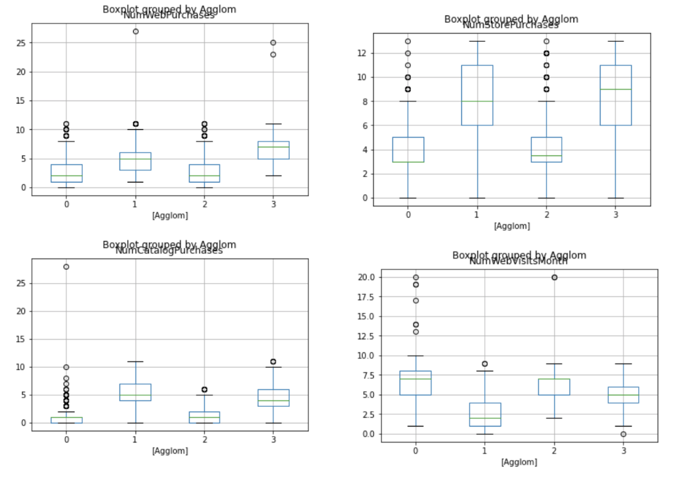
5. Insights
Plot analysis of places feature

Slide 35
5. Insights
Conclusions of the Agglomerative model:
The conclusions of the Agglomerative model are similar to the conclusions of K-Means.
The main effect of this model is to prove the correction of model K mean.

Slide 36
5. Insights
Try to analyze the categorical variables by K medoids Clustering
The conclusions about numerical variables are the same as the conclusions of previous models.
We will focus on the categorical variables.

Slide 37
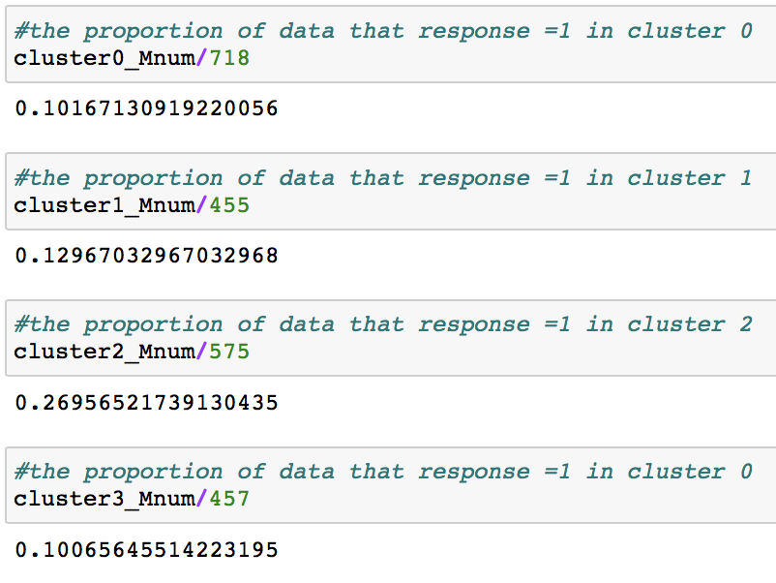
5. Insights
We have 4 clusters. There are 718 in cluster 0, 455 in cluster 1, 575 in cluster 2, 457 in cluster 3. It is similar to the previous steps where we first found the target cluster.
From this figure, we found that cluster 2 has
the highest proportion of data whose
response is equal to 1.

Slide 38
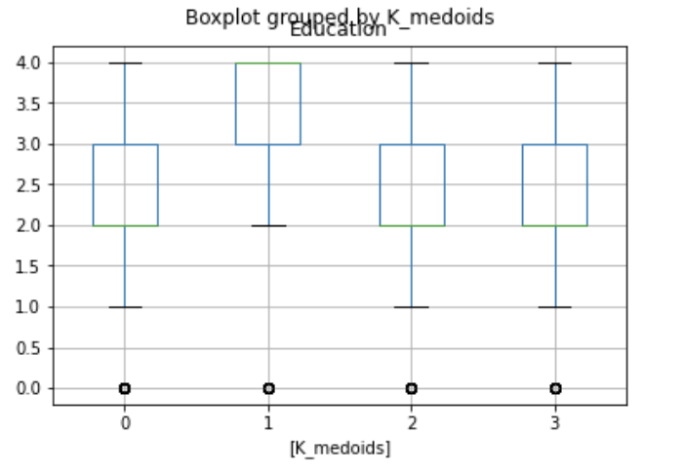
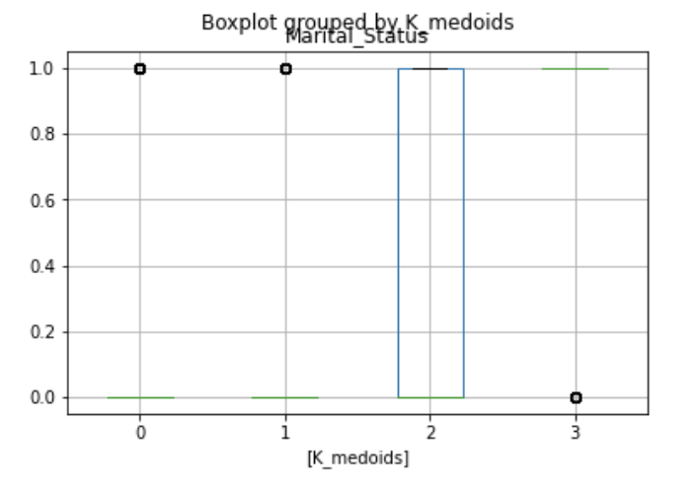
5. Insights

Slide 39
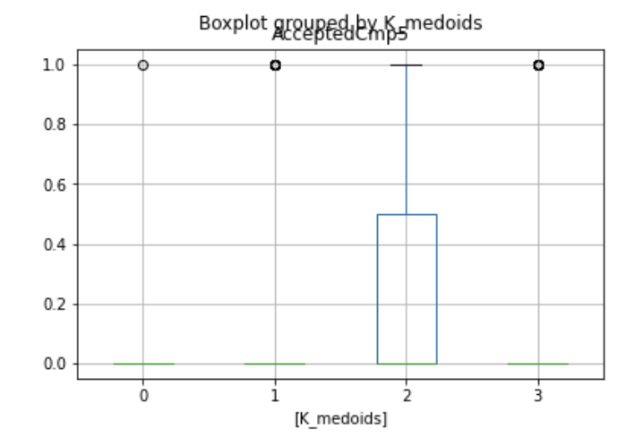
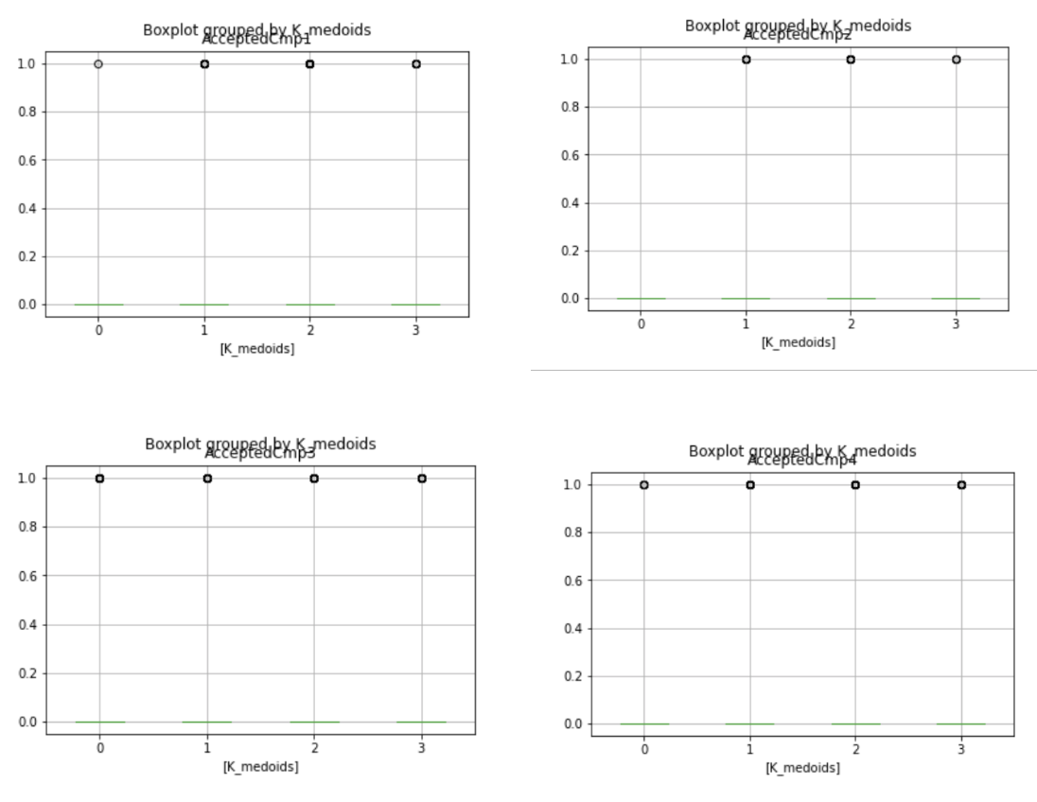
5. Insights
The only categorical feature that has obvious influence is AcceptedCmp5. Therefore, if customers accept the offer in campaign 5, they are more likely to accept the offer in the last campaign.

Slide 40
5. Insights
Conclusions of the K_Medoids model:
The results of numerical variables are similar to the previous results.
We focused on the analysis of categorical features in this model, and found that Marital_Status is not an important feature because marital status cannot directly determine the number of children. The only categorical feature that has significant influence is AcceptedCmp5. Therefore, the company should focus on the customers who accepted the offer in the 5th campaign, which can indicate the customer’s willingness to spend.

Slide 41
6. Conclusions
From the above analysis, we conclude that the company should consider customers who have strong consuming ability and are more willing to consume. This is because customers’ consuming ability is the most significant factor, followed by their willingness to consume.
The features can influence these factors are
“Num_Children”, “Spending”, “NumWebPurchase” and “AcceptedCmp5”.

Slide 42
6. Conclusions
Low Num_Children means strong consuming ability.
High Spending indicates that these customers have more willingness to consume.
High NumWebPurchase means potential waste in life, leading to a decline in consuming ability.
AcceptedCmp5 = 1 indicates that customers just accepted the offer in the fifth campaign (which is the most recent campaign), thus they are likely to accept the offer again in a new campaign.

Slide 43
6. Conclusions
Our best target is people who have strong consuming ability. For these customers, high spending which means they are more willing to consume is an important feature we should consider. However, for customers who have weak consuming ability because of too many children, we should first consider whether they have the ability to accept our offer. Thus, for those customers, lower spending means they are more likely to have the ability to accept the offer.
If we are sure the customers have the ability to accept the offer, we will prefer to see them have more willness to consume.

Slide 44

Thank You!

Slide 45

Any questions?

